Slide 1

Working with TensorFlow
Notes:
1

Slide 2
Objectives
Understand the basic of TensorFlow
The application of TensorFlow
Working with TensorFlow
2
Notes:
2

Slide 3
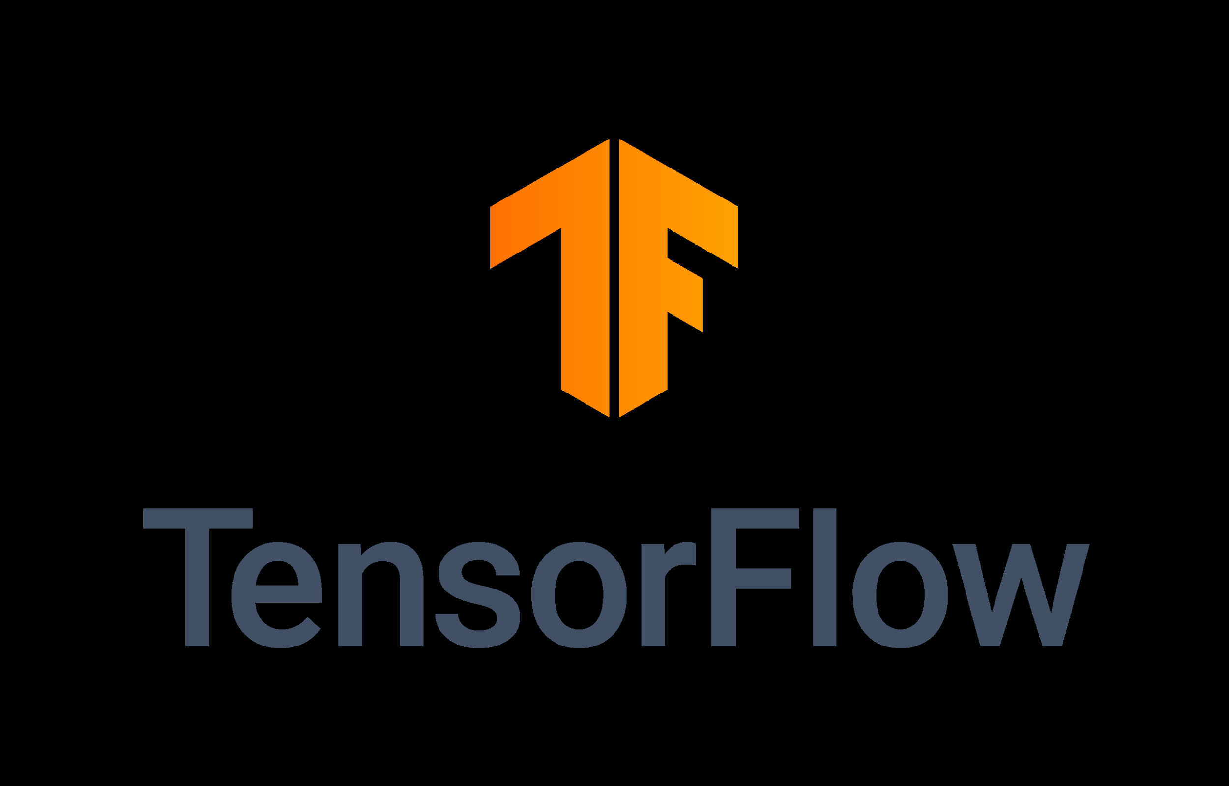
TensorFlow
Tf lite
optuna
Auto Keras
NVIDIA chạy được thì chạy TensorRT
TensorFlow is an end-to-end open source platform for machine learning
TensorFlow makes it easy for beginners and experts to create machine learning
Focus on training and inference of deep neural networks.
3
Working with TensorFlow
Notes:
3

Slide 4
TensorFlow
TensorFlow was developed by the Google Brain team for internal Google use in research and production.
It supports the following:
  Multidimensional-array based numeric computation (similar to NumPy)
  GPU and distributed processing -> Xử lý GPU và phân luồng xử lý
  Automatic differentiation -> Tự động tính đạo hàm
  Model construction, training, and export
Tìm hiểu về Gradient Descent
Tìm hiểu lại về đạo hàm -> Slope
-> Giá trị đạo hàm bằng đúng giá trị thay đổi.
4
Working with TensorFlow
Notes:
4

Slide 5
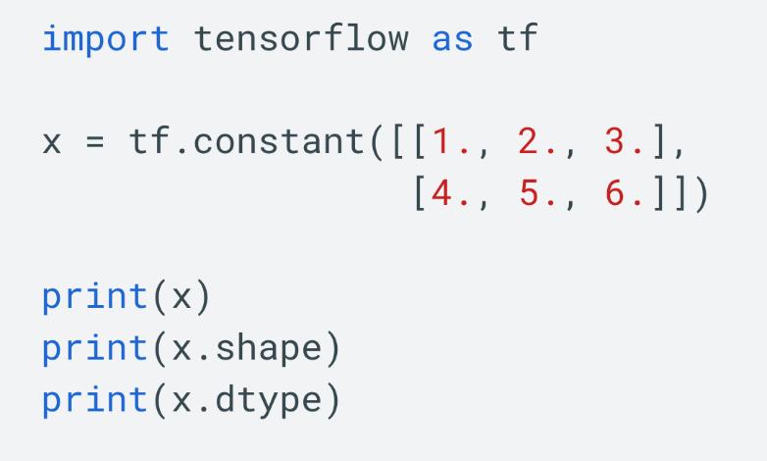
TensorFlow
TensorFlow operates on multidimensional arrays or tensors represented as tf.Tensor objects. Here is a two-dimensional tensor:
  Tensor.shape: the size of the tensor along each of its axes.
  Tensor.dtype: the type of all the elements in the tensor.
5
Working with TensorFlow
Notes:
5

Slide 6
TensorFlow
TensorFlow can be used in a wide variety of programming languages, including Python, JavaScript, C++, and Java
TensorFlow can run on multiple CPUs and GPUs, TPUs (with optional CUDA and SYCL extensions for general-purpose computing on graphics processing units).
TensorFlow is available on 64-bit Linux, macOS, Windows, and mobile computing platforms including Android and iOS.
6
Working with TensorFlow
Notes:
6

Slide 7

TensorFlow
Tensor processing unit (TPU), an application-specific integrated circuit (ASIC, a hardware chip) built specifically for machine learning and tailored for TensorFlow.
TensorFlow's APIs use Keras to allow users to make their own machine learning models.
7
Working with TensorFlow
Notes:
7

Slide 8
TensorFlow
Tìm hiểu autokeras, nó tự động tối ưu mô hình tham số, thử từng layer, nó tự điều chỉnh toàn bộ tham số.
Keras is the high-level API of the TensorFlow platform. It provides an approachable, highly-productive interface for solving machine learning (ML) problems, with a focus on modern deep learning.
Keras covers every step of the machine learning workflow, from data processing to hyperparameter tuning to deployment.
It was developed with a focus on enabling fast experimentation.
8
Working with TensorFlow
Notes:
8

Slide 9
TensorFlow
The core data structures of Keras are layers and models. A layer is a simple input/output transformation, and a model is a directed acyclic graph (DAG) of layers.
Layers: the tf.keras.layers.Layer class is the fundamental abstraction in Keras. A Layer encapsulates a state (weights) and some computation (defined in the tf.keras.layers.Layer.call method).
9
Working with TensorFlow
Notes:
9

Slide 10
TensorFlow
Models is an object that groups layers together and that can be trained on data.
The tf.keras.Model class features built-in training and evaluation methods:
  tf.keras.Model.fit: Trains the model for a fixed number of epochs.
  tf.keras.Model.predict: Generates output predictions for the input samples.
  tf.keras.Model.evaluate: Returns the loss and metrics values for the model; configured via the tf.keras.Model.compile method..
10
Working with TensorFlow
Notes:
10

Slide 11
TensorFlow
Tensorflow Projects for Beginners
  Driver Demand Prediction Project
  Fake News Classification with TensorFlow
  Plant Species Identification
  Speech Emotion Recognition using TensorFlow
  Ultrasound Nerve Segmentation
  Time Series Forecasting.
11
Working with TensorFlow
Notes:
11

Slide 12
TensorFlow
Tensorflow Machine Learning Projects for Aspiring Data Scientist:
  NLP based ChatBot
  Dogs and Cats Classification with TensorFlow
  Object Detection Machine Learning Project with TensorFlow
  Real-time Image Animation Project
  Plant Disease Detection Robot
  Reinforcement Learning Game Player employing TensorFlow
12
Working with TensorFlow
Notes:
12

Slide 13
TensorFlow
Advanced TensorFlow Machine Learning Projects:
  Lung Cancer Detection using TensorFlow
  Gender Recognition Using Voice
  Detecting Spam using TensorFlow
  Optical Character Recognition using TensorFlow
  Face Recognition using TensorFlow
  Breast Cancer Classification Project using TensorFlow
  Real-time Hand Gesture Recognition using TensorFlow
13
Working with TensorFlow
Notes:
13

Slide 14
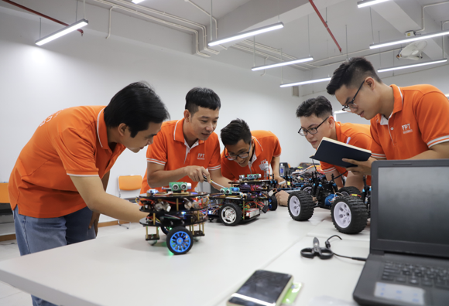
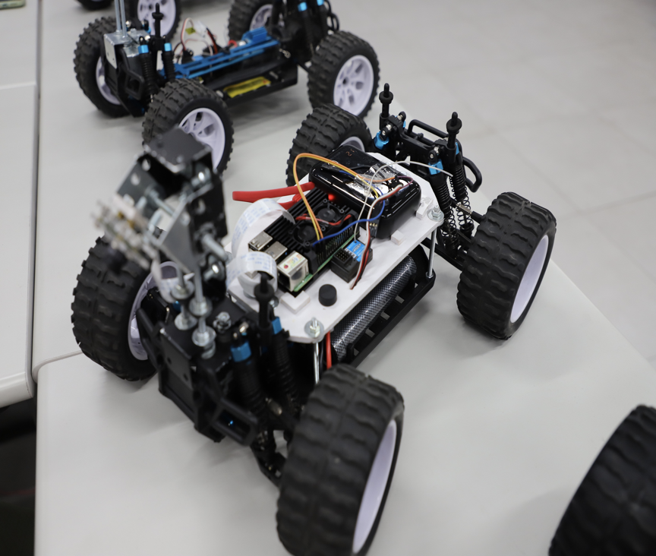
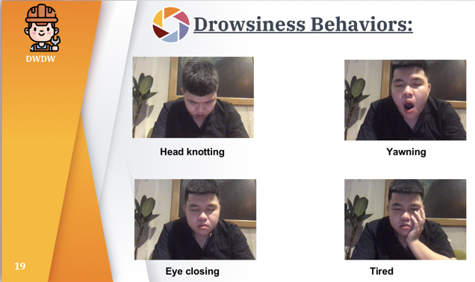
FPTU’s Projects
14
Working with TensorFlow
Notes:
14

Slide 15
Summary
Understand the basic of TensorFlow
The application of TensorFlow
Working with TensorFlow
15

Slide 16
Q & A
Working with TensorFlow
16

